Slide 1
Credit Card Fraud Detection Using Machine Learning
Submitted in the partial fulfillment for the award of the degree of
BACHELOR OF ENGINEERING
IN
Computer Science and Engineering (Hons.) with AIML
Submitted by:
ARYAN VERMA PRAVINKUMAR GOHIL
21BCS6199 21BCS6218
ARCHIT DOGRA
21BCS6215
Under the Supervision of:
MS. TANVI(E15506)
Department of AIT-CSE
DISCOVER . LEARN . EMPOWER

Slide 2
Outline
Introduction to Project
Problem Formulation
Objectives of the work
Methodology used
Results and Outputs
Conclusion
Future Scope
References

Slide 3
Introduction to Project
The main goal of this research is to develop an AI-driven fraud model that can classify transactions as legitimate or fraudulent, thereby reducing negative and bad situations.
The challenges include a serious lack of classes available in the database, where the number of legitimate transactions far exceeds the number of fraudulent transactions.
We have introduced a feature that allows users to instantly submit transaction information and receive fake personal transactions.

Slide 4
Problem Formulation
The project focuses on developing a machine learning model that can accurately classify credit card transactions as either legitimate or fraudulent based on historical transaction data.
The project uses a publicly available credit card fraud detection dataset, which contains anonymized transaction data along with a binary class label (0 for legitimate transactions and 1 for fraudulent transactions). Key steps include: •
Data Preprocessing: Checking for missing values, analyzing class distribution, and addressing class imbalance through sampling techniques.
Exploratory Data Analysis (EDA): Conducting a detailed EDA to understand the transaction patterns and relationships among features. •
Model Training and Evaluation: Training a logistic regression model, chosen for its interpretability, on a balanced dataset and evaluating it with metrics such as accuracy, precision, recall, F1-score, and confusion matrix. •
Real-Time Prediction Capability: Integrating a file upload feature that allows users to submit transaction data for fraud prediction.

Slide 5
Objectives of the Work
The main objectives of this project are to:
1) accurately detect fraudulent transactions in a highly imbalanced dataset,
2) reduce false positives and false negatives to avoid inconveniencing legitimate customers,
3) address class imbalance using techniques like under-sampling and synthetic sampling (e.g., SMOTE), and
4) create a user-friendly interface that enables real-time predictions by allowing users to upload transaction data, simulating practical applications for financial institutions.

Slide 6
Methodology used
The methodology used in this project are to:
Dataset Overview: The dataset from the UCI Repository includes 284,807 transactions with 31 features, and is highly imbalanced, with fraudulent transactions comprising only 0.17%.
Data Preprocessing: No missing values were present, so the dataset required no imputation. Class imbalance analysis indicated the need for undersampling or oversampling to improve the model’s predictive accuracy.
Model Selection: Logistic regression was chosen for its simplicity and interpretability, allowing for clear probability outputs and feature importance analysis in fraud detection.
Model Evaluation: Performance metrics included accuracy, precision, recall, F1-score, and a confusion matrix to ensure effective detection of fraudulent transactions within the imbalanced dataset.
Model Interpretability and Outlier Handling: Logistic regression coefficients were analyzed to interpret feature importance, and robust scaling was applied to reduce the influence of outliers, preserving critical fraud data.

Slide 7
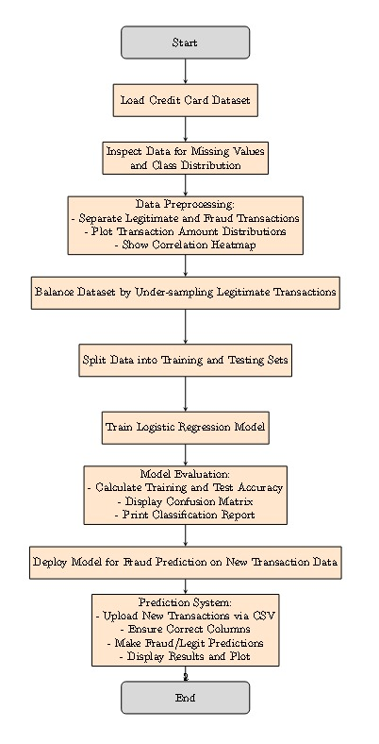
Methodology used

Slide 8
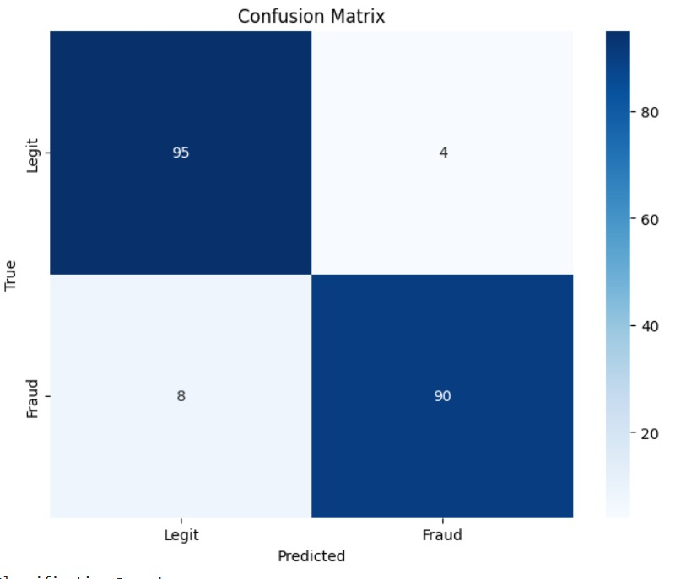
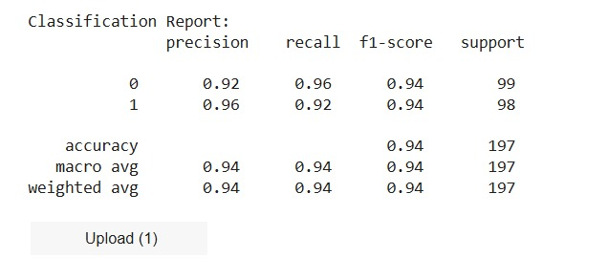
Results and Outputs
The project effectively develops a logistic regression-based fraud detection system that addresses class imbalance with techniques like SMOTE, achieves high precision and recall for identifying fraudulent transactions, includes real-time prediction capabilities, and suggests future improvements such as complex models and enhanced feature engineering for improved accuracy and adaptability.

Slide 9
Conclusion
In conclusion, this project demonstrates that machine learning, specifically logistic regression, provides a robust foundation for credit card fraud detection. With careful data preprocessing and balancing techniques, this approach shows strong potential for integration into real-world financial systems, where it can aid in preventing fraud and safeguarding customers and institutions from financial losses.

Slide 10
Future Scope
Advanced Model Exploration: Investigating complex models like Random Forests, Gradient Boosting, and neural networks, along with ensemble methods, can improve fraud detection accuracy by capturing non-linear relationships and reducing bias.
Enhanced Data Balancing and Feature Engineering: Utilizing advanced balancing methods (SMOTE, ADASYN) and creating domain-specific features, such as time-based and geolocation patterns, can improve model performance on imbalanced datasets and reveal subtle fraud indicators.
Real-Time Deployment and Continuous Adaptation: Deploying the model in real-time with low-latency optimizations, adaptive learning for evolving fraud patterns, explainable AI techniques for transparency, and continuous monitoring for maintaining performance can ensure effective, responsive, and trustworthy fraud detection.

Slide 11
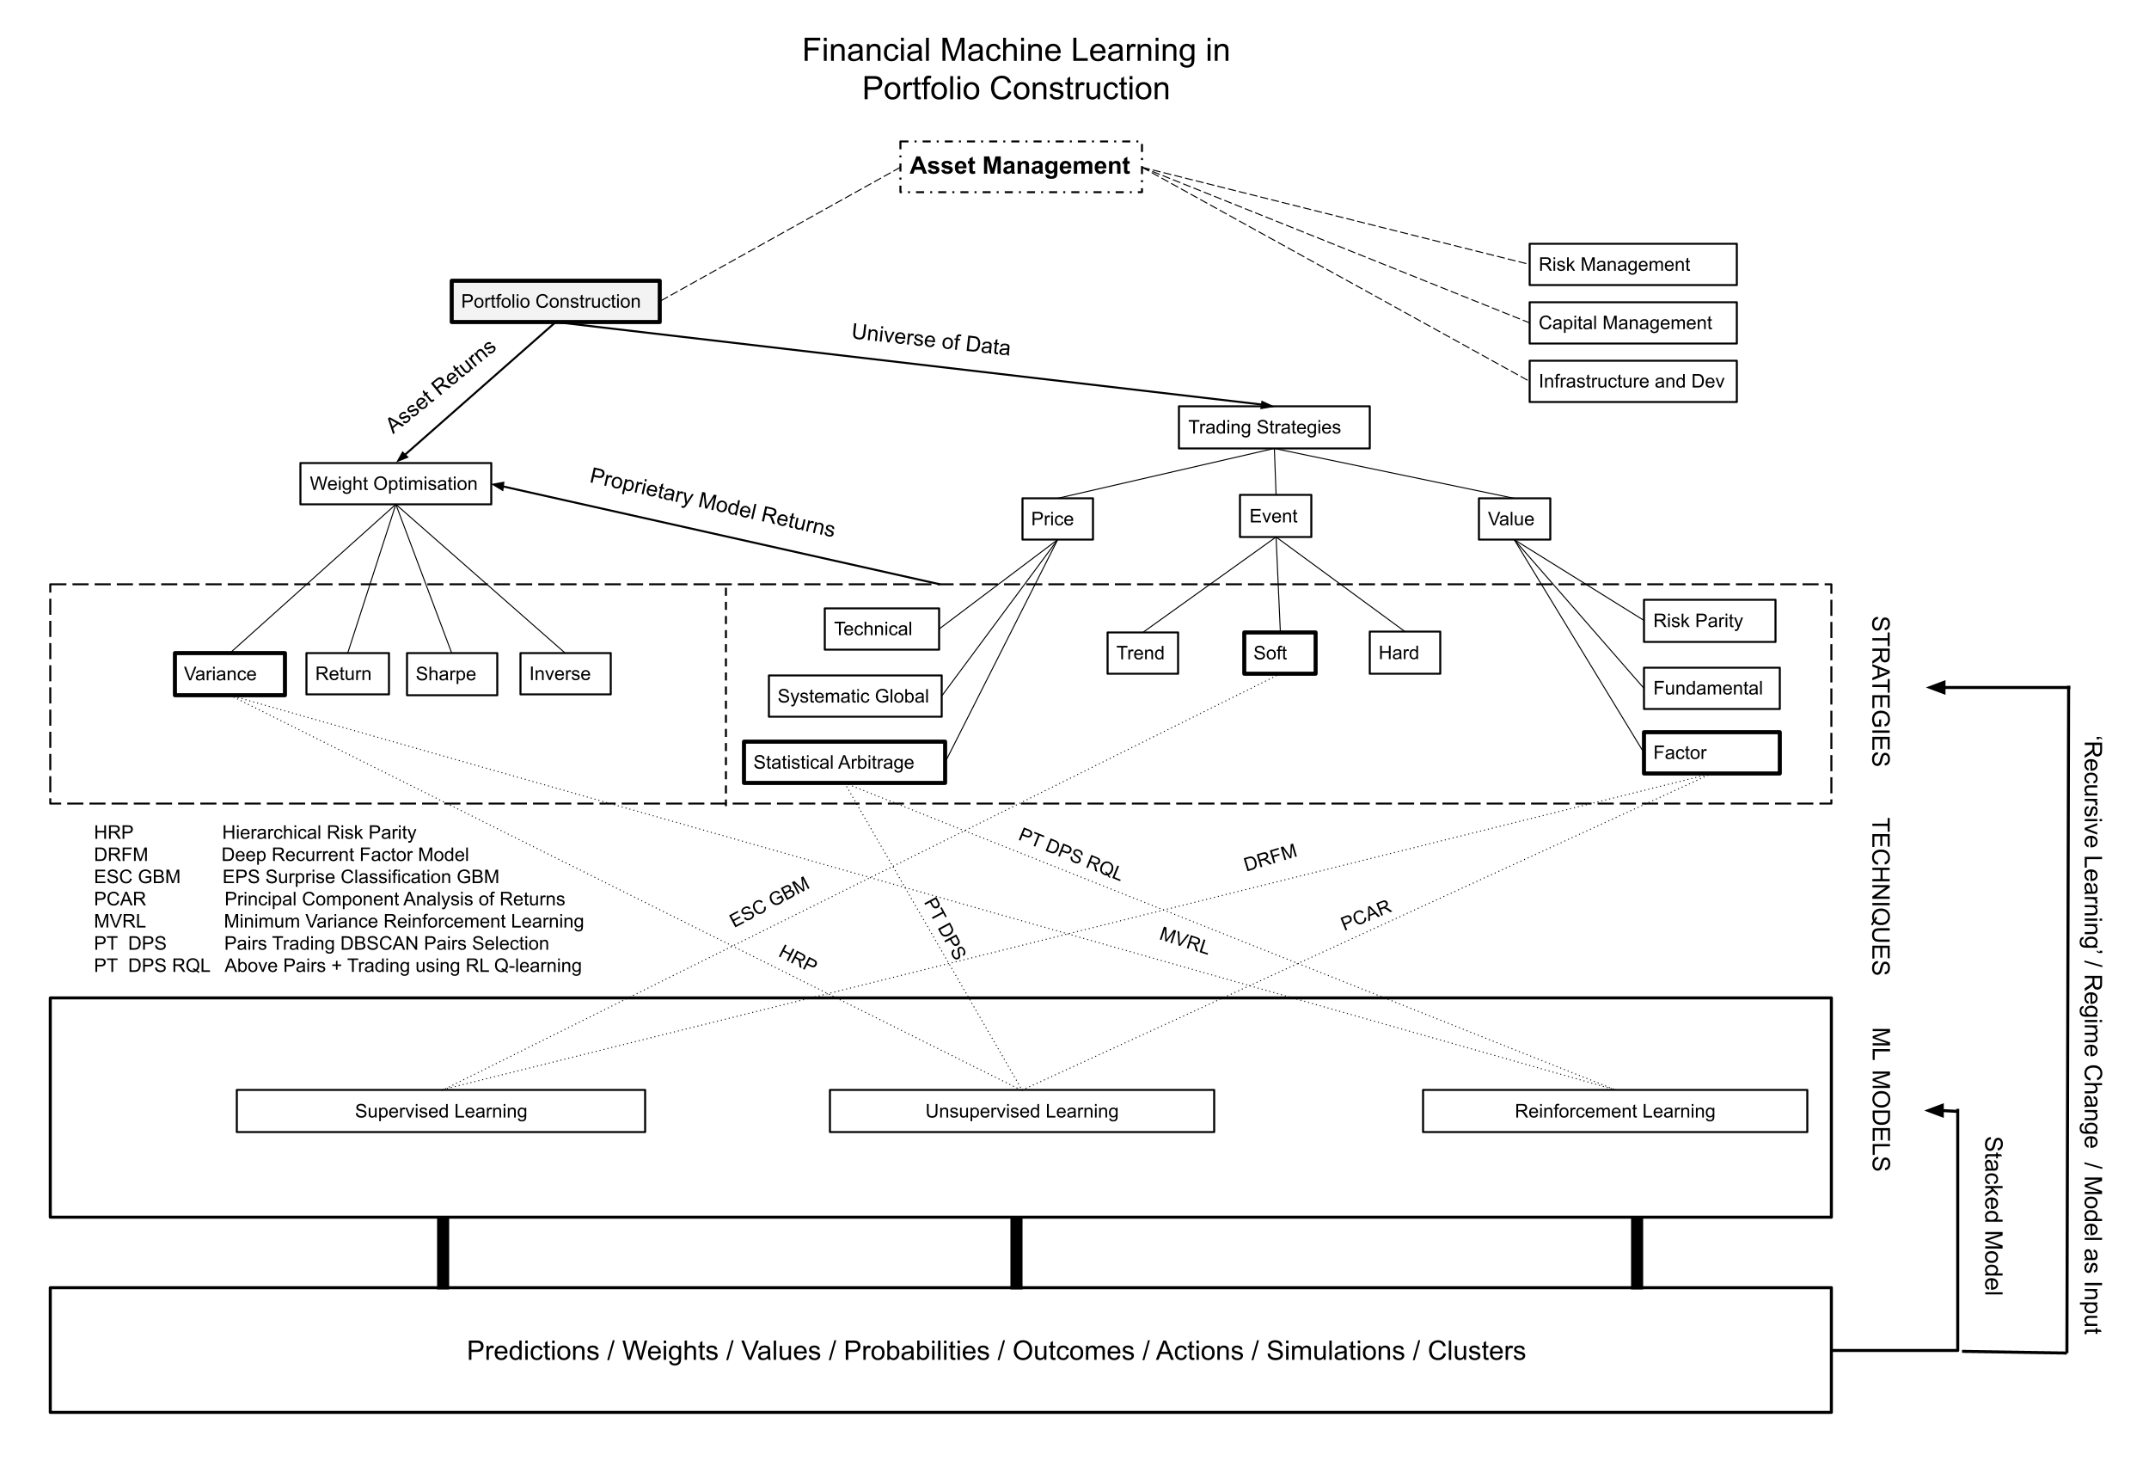
Future Scope

Slide 12
References
[1] Aisha Abdallah, Mohd Aizaini Maarof, and Anazida Zainal. Fraud detection system: A survey. Journal of Network and Computer Ap- plications, 68:90– 113, 2016.
[2] Zeeshan Akram, Mamoona Majid, and Shaista Habib. A systematic literature review: usage of logistic regression for malware detection. In 2021 International Conference on Innovative Computing (ICIC), pages 1–8. IEEE, 2021.
[3] Abdulalem Ali, Shukor Abd Razak, Siti Hajar Othman, Taiseer Ab- dalla Elfadil Eisa, Arafat Al-Dhaqm, Maged Nasser, Tusneem Elhassan, Hashim Elshafie, and Abdu Saif. Financial fraud detection based on machine learning: a systematic literature review. Applied Sciences,12(19):9637, 2022.
[4] Credit card fraud detec- tion using machine learning algorithms. Procedia computer science, 165:631–641, 2019.
[5] Ella Mae Matsumura and Robert R Tucker. Fraud detection: A theoretical foundation. Accounting Review, pages 753–782, 1992.
[6] Min Seok Mok, So Young Sohn, and Yong Han Ju. Random effects logistic regression model for anomaly detection. expert systems with applications, 37(10):7162–7166, 2010.
[7] Ruttala Sailusha, V Gnaneswar, R Ramesh, and G Ramakoteswara Rao. Credit card fraud detection using machine learning. In 2020 4th international conference on intelligent computing and control systems (ICICCS), pages 1264–1270. IEEE, 2020.

Slide 13
Thank-You

